Slide 1
Decision Tree Tutorial

Slide 2
Agenda
Introduction
Fundamentals
Terminology
Pros and Cons
Example Using CART
Regression Model Trees
C5.0 Algorithms
Feature Selection: Cricket Players example
Simple Case Study: Predicting Class Membership using synthetic 2D data
Practical Case Study: Predicting Authenticity of Bank Notes
Model Fine Tuning

Slide 3
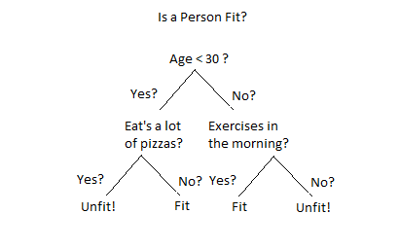
Introduction
What is a Decision Tree ?
An Example of a Decision Tree
Decision tree is a type of supervised learning algorithm (having a pre-defined target variable) that is mostly used in classification problems.
How does it work ?
It works for both categorical and continuous input and output variables.
In this technique, we split the population or sample into two or more homogeneous sets (or sub-populations) based on most significant splitter / differentiator in input variables.

Slide 4
The Key Questions asked
For every node (including the root node), how should we choose the input feature to split on and, given this feature, what is the value of the split point?
How do we decide whether a node should become a leaf node or if we should make another split point?
How deep should our tree be allowed to become?
Once we arrive at a leaf node, what value should we predict?

Slide 5
Terminology
Categorical Variable Decision Tree: Decision Tree which has categorical target variable (YES /NO) (1/0) then it called as categorical variable decision tree.
Continuous Variable Decision Tree: Decision Tree has continuous target variable then it is called as Continuous Variable Decision Tree.
Types of Decision Trees
Root Node: It represents entire population or sample and this further gets divided into two or more homogeneous sets.
Splitting: It is a process of dividing a node into two or more sub-nodes.
Decision Node: When a sub-node splits into further sub-nodes, then it is called decision node.
Leaf/ Terminal Node: Nodes do not split is called Leaf or Terminal node.
Pruning: When we remove sub-nodes of a decision node, this process is called pruning. You can say opposite process of splitting.
Branch / Sub-Tree: A sub section of entire tree is called branch or sub-tree.
Root Node
Split
Sub tree
Decision Node
Decision Node
Terminal Node
Decision Node
Terminal Node
Terminal Node
Terminal Node
Terminal Node

Slide 6
Pros and Cons for Decision Tree
Pros
Cons
Easy to Understand: Decision tree output is very easy to understand Its graphical representation is very intuitive and users can easily relate their hypothesis.
Useful in Data exploration: Decision tree is one of the fastest way to identify most significant variables and relation between two or more variables.
Less data cleaning required:. It is not influenced by outliers and missing values to a fair degree.
Data type is not a constraint: It can handle both numerical and categorical variables.
Non Parametric Method: This means that decision trees have no assumptions about the space distribution and the classifier structure
Over fitting Over fitting is one of the most practical difficulty for decision tree models.
Not fit for continuous variables: While working with continuous numerical variables, decision tree looses information when it categorizes variables in different categories.

Slide 7
Classification Vs Regression Trees
Classification Trees
What is different !!!
Regression Trees
Categorical dependent variables
Value obtained at terminal node is mode of observations at that location
Continuous dependent variables
Value obtained at terminal node is mean of observations at that location
And what is not!!!
Both Follow Top down ‘ Greedy ‘ Approach
Algo cares about current best split and does not look ahead (Greedy)
Split continues till user defined STOP criteria reached
Both result in ‘fully grown’ trees hence ‘Pruning’ is needed

Slide 8
Splitting criteria
Underlying Concept
Decision tree splits the nodes on all available variables and then selects the split which results in most homogeneous sub-nodes.
Splitting Algorithms commonly used
Gini index
Chi Square
Information Gain
Reduction in Variance
Categorical target variable
Categorical target variable
Categorical target
variable
Only Binary splits
Two or more splits
Completely Pure Entropy = 0
Higher Gini , more homogeneity
Higher Chi Sq , Higher Diff between Child and Parent
Equally divided Entropy = 1
Used in CART
Used in CHAID

Slide 9
Example using CART
Key steps
At any given point we decide on the input feature and value of the split point by computing SSE
We go ahead with the Minimum SSE for the combination
For a leaf node the predicted value is the average of the output predicted by points assigned to that node
Further splits or growing new leaf node is determined by comparing the current data points at a leaf node and comparing with a pre- determined threshold.
Start value of SSE at root node
SSE at node split for a split point

Slide 10
Determining Split Points
Key Steps
Compute SSE for a Feature for a Split Point
Repeat Above for ALL Split points for a Feature
Repeat 1) , 2) Above for All Features
Choose Optimal Feature and Split point Combination to go ahead

Slide 11
R to the Rescue!
Data generation
SSE Compute for Split point
set.seed(99)
x1<-rbinom(20,1,0.5)
set.seed(100)
x2<-round(10+rnorm(20,5,5),2)
set.seed(101)
y<-round((1+(x2*2/5)+x1-rnorm(20,0,3)),2)
rcart_df<-data.frame(x1,x2,y)
rcart_df
compute_SSE_split <- function(v, y, split_point) {
index<-v<split_point
y1<-y[index]
y2<-y[!index]
SSE<-sum((y1-mean(y1))^2) + sum((y2-mean(y2))^2)
return(SSE)
}
ALL Points SSE Compute
compute_all_SSE_splits <- function(v, y) {
sapply(unique(v), function(sp) compute_SSE_split(v,y,sp))
}

Slide 12
Example using CART
Consider set of 20 data points
Variable Description
x1 : feature vector – Random Binary (0,1).
x2 : feature vector - Normal random numbers
y: Output variable

Slide 13
How do the two features fare wrt SSE?
Lowest SSE Value Observed for feature x2 , at point x2 = 18.7
Tree Split rule
If (x2 < 18.7)
Recursive Partitioning
CART used the same methodology to decide feature to split on and split point at each step
This recursive approach of splitting at each node to build the tree is known as Recursive Partitioning

Slide 14
Regression Model Trees : M5 Algorithm
Drawbacks with Traditional Trees
Split would lead to lesser variation within the new groups
Number of data points at a leaf node, though limited may still have high variance
Usual practice of taking the average value as the predicted value is not the best approach
Thus a better split would mean a greater reduction in variance
How is it overcome?
Regression Model Trees (M5 Algorithm )
Linear model employed over all data points at a leaf node to predict output value
Uses Weighted Reduction in Standard Deviation as Split Choice Criteria

Slide 15
CART classification trees: Using Gini Index
Key points
Examples
We aim to achieve leaf nodes having data points belonging to only one class
Ideally we should use a metric which determines node purity
GINI Index is commonly used
Node Data Points: 0,0,0,1,1,1
Gini Index = 0.5
Node Data Points: 0,0,0,1,1,1,1,1,1
Gini Index = 0.44
Notes
Node Data Points: 0,0,0,1,1,1,2,2,2
Gini Index = 0.67
For completely pure node Gini Index = 0
For a equally split node Gini = 0.5 for a Binary Output
E consider the metric : Weighted Reduction in Gini
Node Data Points: 1,1,1,1,1,1
Gini Index = 0.0

Slide 16
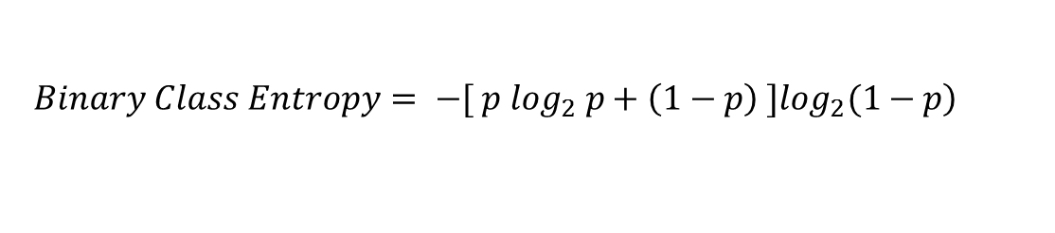
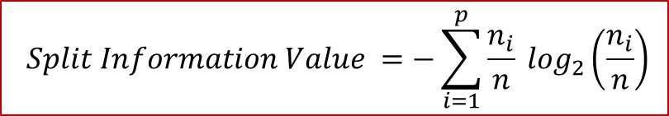
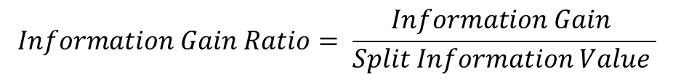
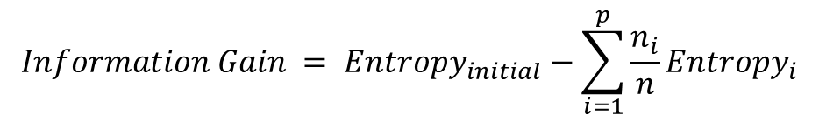
Cart classification trees: C 5.0 - Entropy
Split Criterion
Entropy or Information Statistic
This form is still biased towards categorical variables
Normalized Version
$$\left.Binary Class Entropy= −[ p \log_{2} p+\left(1−p\right) ]\log_{2}(1−p\right)$$
$$Information Gain = {Entropy}_{initial}−\sum_{i=1}^{p}{\frac{n_{i}}{n}{Entropy}_{i}}$$
Thus we used a normalized form
$$Information Gain Ratio= \frac{Information Gain }{Split Information Value }$$
$$Split Information Value =−\sum_{i=1}^{p}{\frac{n_{i}}{n}} \log_{2}\left(\frac{n_{i}}{n}\right)$$

Slide 17
Example for Feature Selection: Cricket Players
Given
Let’s say we have a sample of 30 students with three variables Gender (Boy/ Girl), Class( IX/ X) and Height (5 to 6 ft). 15 out of these 30 play cricket in leisure time.
Need
A model to predict who will play cricket during leisure period?
We need to segregate students who play cricket in their leisure time based on highly significant input variable among all three.
Essence of solution
How can a decision tree help?
This is where decision tree helps, it will segregate the students based on all values of three variable and identify the variable, which creates the best homogeneous sets of students (which are heterogeneous to each other).

Slide 18

Example contd.
Gender Split
Split on Height
Split on Class
Students = 30
Play Cricket = 15 (50%)
< 5.5 ft
>= 5.5 ft
Class IX
Class X
Students = 10
Play Cricket = 2 (20%)
Students = 20
Play Cricket = 13 (65%)
Students = 12
Play Cricket = 5 (42%)
Students = 18
Play Cricket = 10 (56%)
Students = 14
Play Cricket = 6 (43%)
Students = 16
Play Cricket = 9 (56%)
Observations
In this example we see that Split by Gender leads to the best separation of Cricket Playing and Non Playing groups

Slide 19
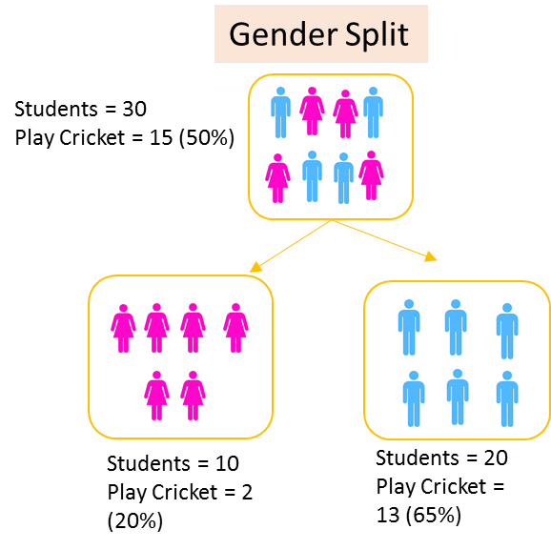
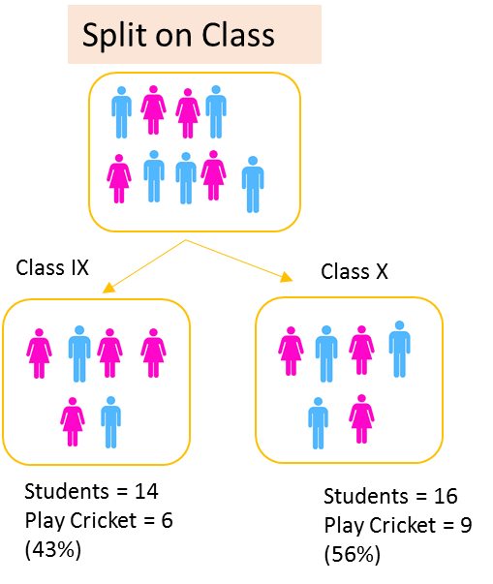
Example on Gini Index
Steps to compute Gini
Calculate Gini for sub-nodes, using formula sum of square of probability for success and failure (p^2+q^2)
Calculate Gini for split using weighted Gini score of each node of that split
Gender and Class Splits
Gender and Class Gini
Gender
Class
Female sub node
p =0.2, q = 0.8
Gini = 0.68
Cl IX sub node
p =0.43, q = 0.57
Gini = 0.51
Female sub node
p =0.65, q = 0.35
Gini = 0.55
CL X sub node
p =0.56, q = 0.44
Gini = 0.51
Male sub node
Male sub node
Weighted Gender Gini
Weighted Gender Gini
Male Wt = 20/30
Female Wt = 10/30
Gini = (10/30)*0.68 + (20/30)*0.55
= 0.59
Cl IX Wt = 14/30
Female Wt = 16/30
Gini = (14/30)*0.51 + (16/30)*0.51
= 0.51
Gender gives the better split !

Slide 20
Example on Chi Sq
Deviation = (Actual – Expected )
Chi Sq = ((Act – Exp) ^2/(Exp))^1/2
Steps to compute Chi Sq
Calculate Chi-square for individual node by calculating the deviation for Success and Failure both
Calculated Chi-square of Split using Sum of all Chi-square of success and Failure of each node of the split
Gender
Split by gender more significant
Class

Slide 21
Example on Information Gain – Entropy
The concept :
Less Information needed to describe Case C !
A
B
C
Completely Heterogeneous
More Red Dots!
Only Red Dots!

Slide 22
Example on Information gain
Entropy = -plog₂p -qlog₂q
Steps to compute Gini
Information gain = 1 - Entropy
Calculate entropy of parent node
Calculate entropy of each individual node of split and calculate weighted average of all sub-nodes available in split.
Entropy for Gender Split
Entropy for Class Split
Parent Node
p =0.5, q = 0.5
Entropy = - 0.5*log2(0.5) –
0.5*log2(0.5) = 1 (Impure Node)
p =0.5, q = 0.5
Entropy = - 0.5*log2(0.5) –
0.5*log2(0.5) = 1 (Impure Node)
Parent Node
Female node
p =0.2, q = 0.8
Entropy = - 0.2*log2(0.2)
– 0.8*log2(0.8 )
= 0.72
Cl IX node
p = 6/14 , q = 8/14
Entropy = - (6/14)*log2(6/14) –
(8/14)*log2(8/14) = 0.99
Male node
p =0.65, q = 0.35
Entropy = - 0.65*log2(0.65)
– 0.35*log2(0.35 ) = 0.93
Cl X node
p = 9/16 , q = 7/16
Entropy = - (9/16)*log2(0.5) –
(7/16)*log2(0.5) = 0.99
(10/30)*0.72 + (20/30)*0.93 = 0.86
Weighted Entropy
Weighted Entropy
(14/30)*0.99 + (14/30)*0.99
= 0.99
Gender split shows lower entropy

Slide 23
Example on Reduction in Variance
Approach
Uses standard formula of variance
Calculate entropy of each individual node of split and calculate weighted average of all sub-nodes available in split.
Mean = (15*1 + 15*0 ) / 30 = 0.5 ;
We have 15 ones and 15 zeros
Thus Var = (15*((1-0.5)^2) + 15*( (0 – 0.5)^2) )/30
=0.25
Variance for Gender Split
Assign 1 = play; 0 = Not play
Variance for Class Split
Mean = (15*1 + 15*0 ) / 30 = 0.5 ;
We have 15 ones and 15 zeros
Thus Var = (15*((1-0.5)^2) + 15*( (0 – 0.5)^2) )/30
=0.25
Parent
Node
Parent
Node
Mean = (6*1 + 8*0 ) / 14 = 0.43 ;
We have 6 ones and 8 zeros
Thus Var = (6*((1-0.43)^2) + 8*( (0 – 0.43)^2) )/14
=0.24
Mean = (2*1 + 8*0 ) / 10 = 0.2 ;
We have 2 ones and 8 zeros
Thus Var = (2*((1-0.2)^2) + 8*( (0 – 0.2)^2) )/10
= 0.16
Female
node
Class IX
node
Mean = (9*1 + 7*0 ) / 16 = 0.56 ;
We have 9 ones and 7 zeros
Thus Var = (9*((1-0.56)^2) + 7*( (0 – 0.56)^2) )/16
=0.25
Mean = (13*1 + 7*0 ) / 20 = 0.65 ;
We have 13 ones and 7 zeros
Thus Var = (13*((1-0.65)^2) + 7*( (0 – 0.65)^2) )/20
0.23
Male node
Class X
node
(10/30)*0.16 + (20/30)*0.23 = 0.21
(14/30)*0.24 + (16/30)*0.25 = 0.25
Weighted Entropy
Weighted Entropy

Slide 24
Case Study: Class Prediction
Synthetic Class Generation
Class a
Class b
Class c
X1
Y1
X1
Y1
X1
Y1
R norm:
Mean 16
sd 3
R norm:
Mean 14
sd 4
R norm:
Mean 22
sd 8
R norm:
Mean 84
sd 6
R norm:
Mean 49
sd 4
R norm:
Mean 72
sd 2
Class b
Class b
Class c
X1
Y1
X1
Y1
X1
Y1
R norm:
Mean 77
sd 4
R norm:
Mean 86
sd 3
R norm:
Mean 68
sd 3
R norm:
Mean 39
sd 6
R norm:
Mean 88
sd 3.5
R norm:
Mean 10
sd 2.5

Slide 25
Case Study: Class Prediction
Tree Diagram

Slide 26
Case Study : Bank Notes Authenticity
Data Set
banknote authentication data set is hosted at https://archive.ics.uci.edu/ml/datasets/banknote+authentication.

Slide 27
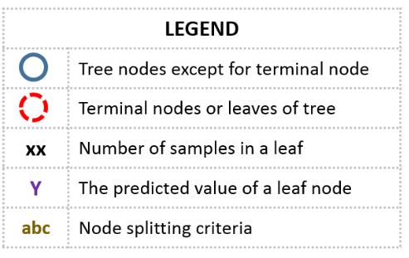
Model Fine Tuning
Max_features :
define nos of features to be considered while doing
each split
Avoid Over Fitting
Setting constraints on tree size
Tree pruning
General Structure of a Decision Tree
A min samples split : of 70 would not allow any node less than 70 samples to be split
a<1
a>=1
100
1
b<=10
30
70
b > 10
1
2
A min_samples_leaf of 30 would not allow any leaf node to have any leaf < 30
30
40

Slide 28
Model Fine Tuning: How constraints work
Measure
Too Low value
Too High value
Min Samples for node split
Over fitting
Under fitting
Min Samples for leaf node
Over fitting; Choose Low values for imbalanced class problems
Under fitting
Max depth of tree
Under fitting
Over fitting
Max Nos of terminal nodes
Can be used in place of Depth: Similar like Max depth
Max features to consider for split
Choose at least 30% to 40% of the features – Avoid Underfitting
Over fitting

Slide 29
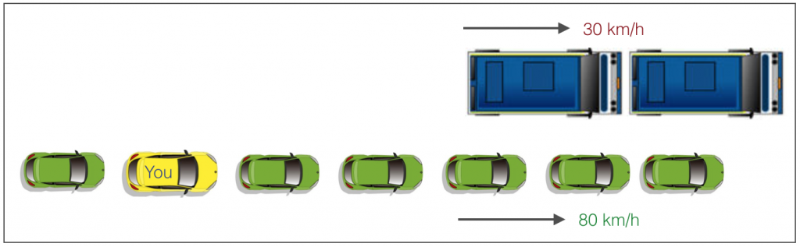
Model Fine Tuning: Greedy Approaches
Why constraint setting maybe greedy ?
Checks for best split immediately
Then Moves ahead till stop criterion reached
Greedy Approach to Overtake

Slide 30

Model Fine Tuning : Tree Pruning
Why Pruning?
A decision tree with constraints won’t see the truck ahead and adopt a greedy approach by taking a left.
On the other hand if we use pruning, we in effect look at a few steps ahead and make a choice.
How it is done
We first make the decision tree to a large depth.
Then we start at the bottom and start removing leaves which are giving us negative returns when compared from the top.
Suppose a split is giving us a gain of say -10 (loss of 10) and then the next split on that gives us a gain of 20. A simple decision tree will stop at step 1 but in pruning, we will see that the overall gain is +10 and keep both leaves
Image: http://www.treeremoval.com/trimming-and-pruning/

Slide 31
The Key Decision To Make!
Which Model should I choose and when ?
Scenario
Suggested Model
Dependence between dependent and independent variables is linear
Linear Regression
High non linearity and complex relationship between independent and dependent variables
Tree model

Slide 32
Thanks

